Slide 1
Nonlinear Finite Volume Methods For Coupled Problems
Kirill Terekhov, Yuri Vassilevski, Hamdi Tchelepi
35th SUPRI-B Annual Meeting

Slide 2
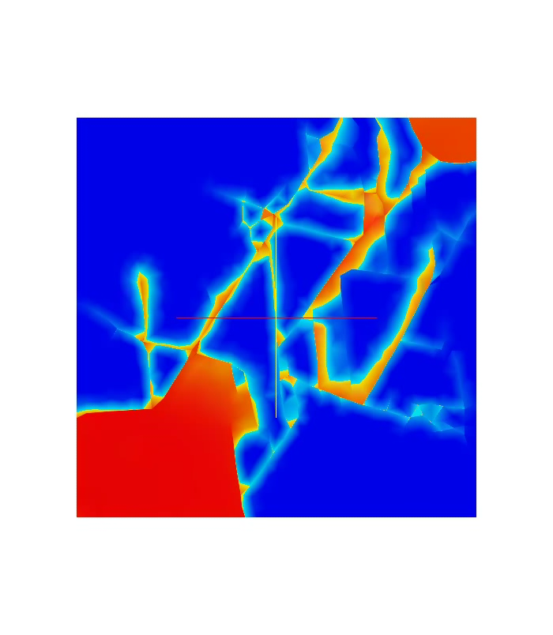
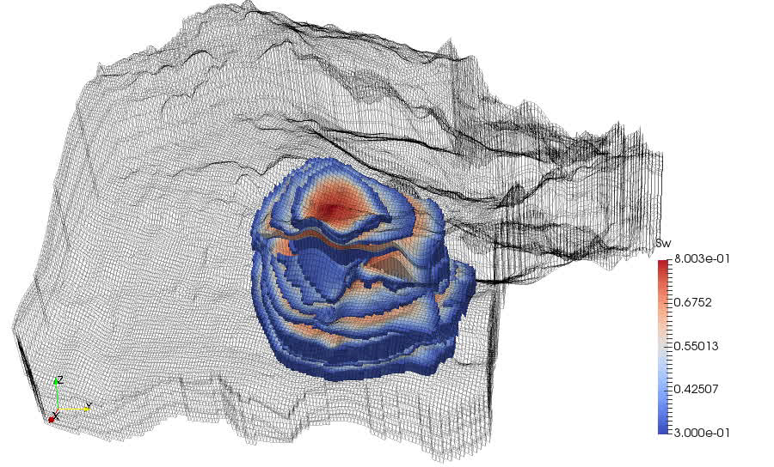
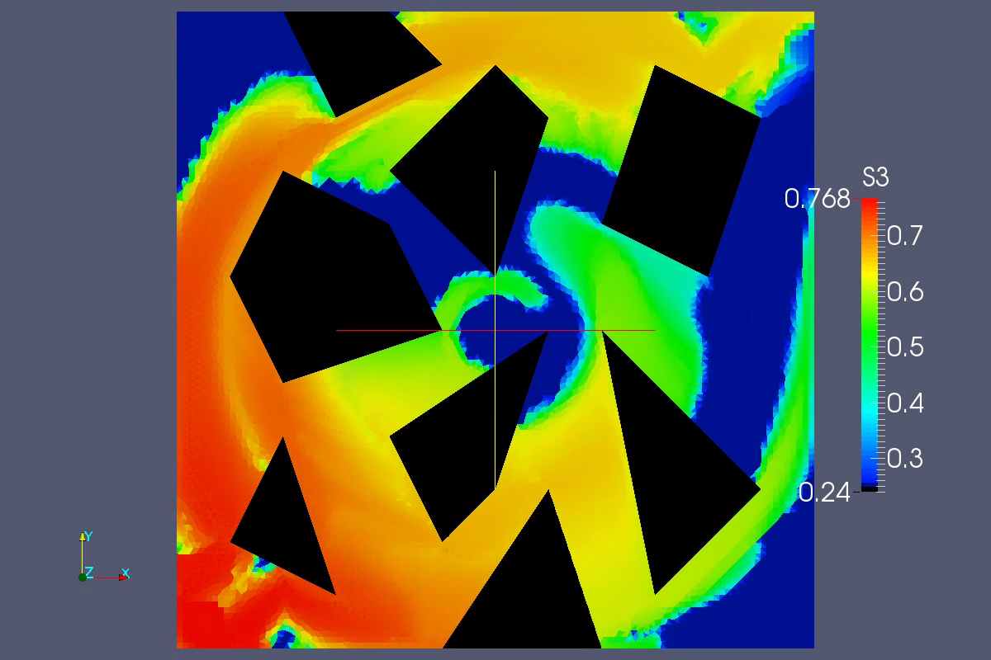
Complexity of Reservoir Simulation
Strong anisotropy
Fractures
Complex geology and geometry of grids
Notes:
The reservoir simulation involves consideration of a lot of complex effects. (First video) Simulation is performed on complex unstructured non-orthogonal grids with faults, pinch-outs and degeneracies. Such grids are required to represent layered underground media. (Second video) Another level of complexity is introduced by the rock properties such as permeability that is usually characterized by heterogeneity and anisotropy and it affects the direction of the flow in tremendous way resulting in complex flow pattern and necessity to robustly represent such flows. (Third video) Another level of complexity is introduced by necessity to account for fractures, that are characterized by either very high conductivity (open fractures) or no conductivity (closed fractures). In all of these cases the conservation is an important property that leads to the use of finite volume discretization Calibrimethods. These all complexities are covered by discretization toolkit that is now incorporated into AD-GPRS simulator. In the present work let us recall some aspects of finite volume methods present in discretization toolkit and let us extend the design of the methods onto methods with different physics.

Slide 3
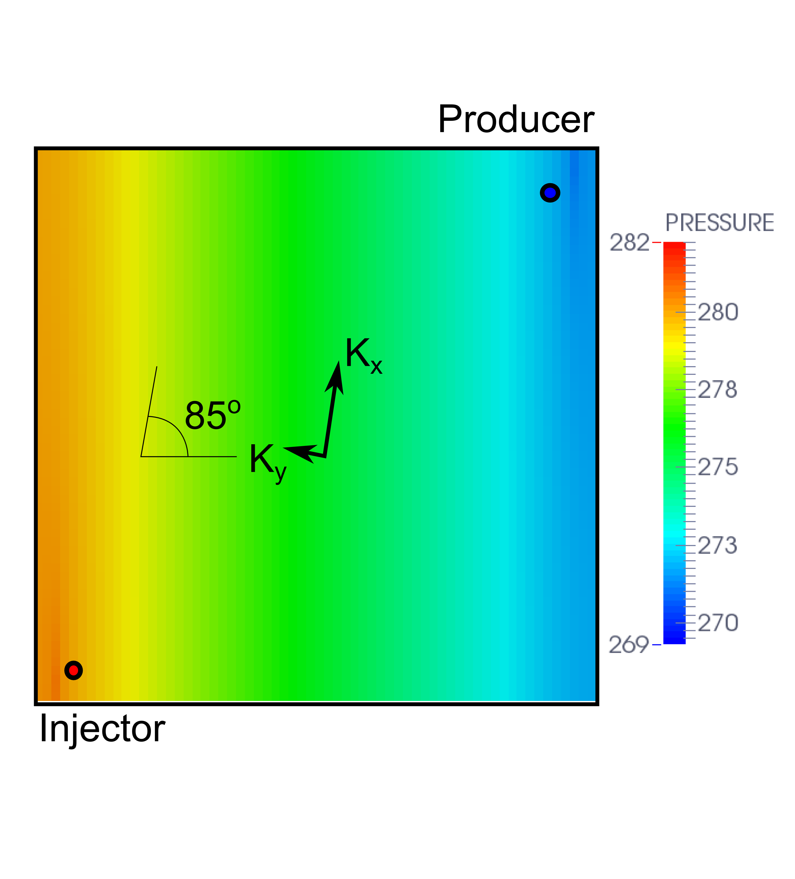
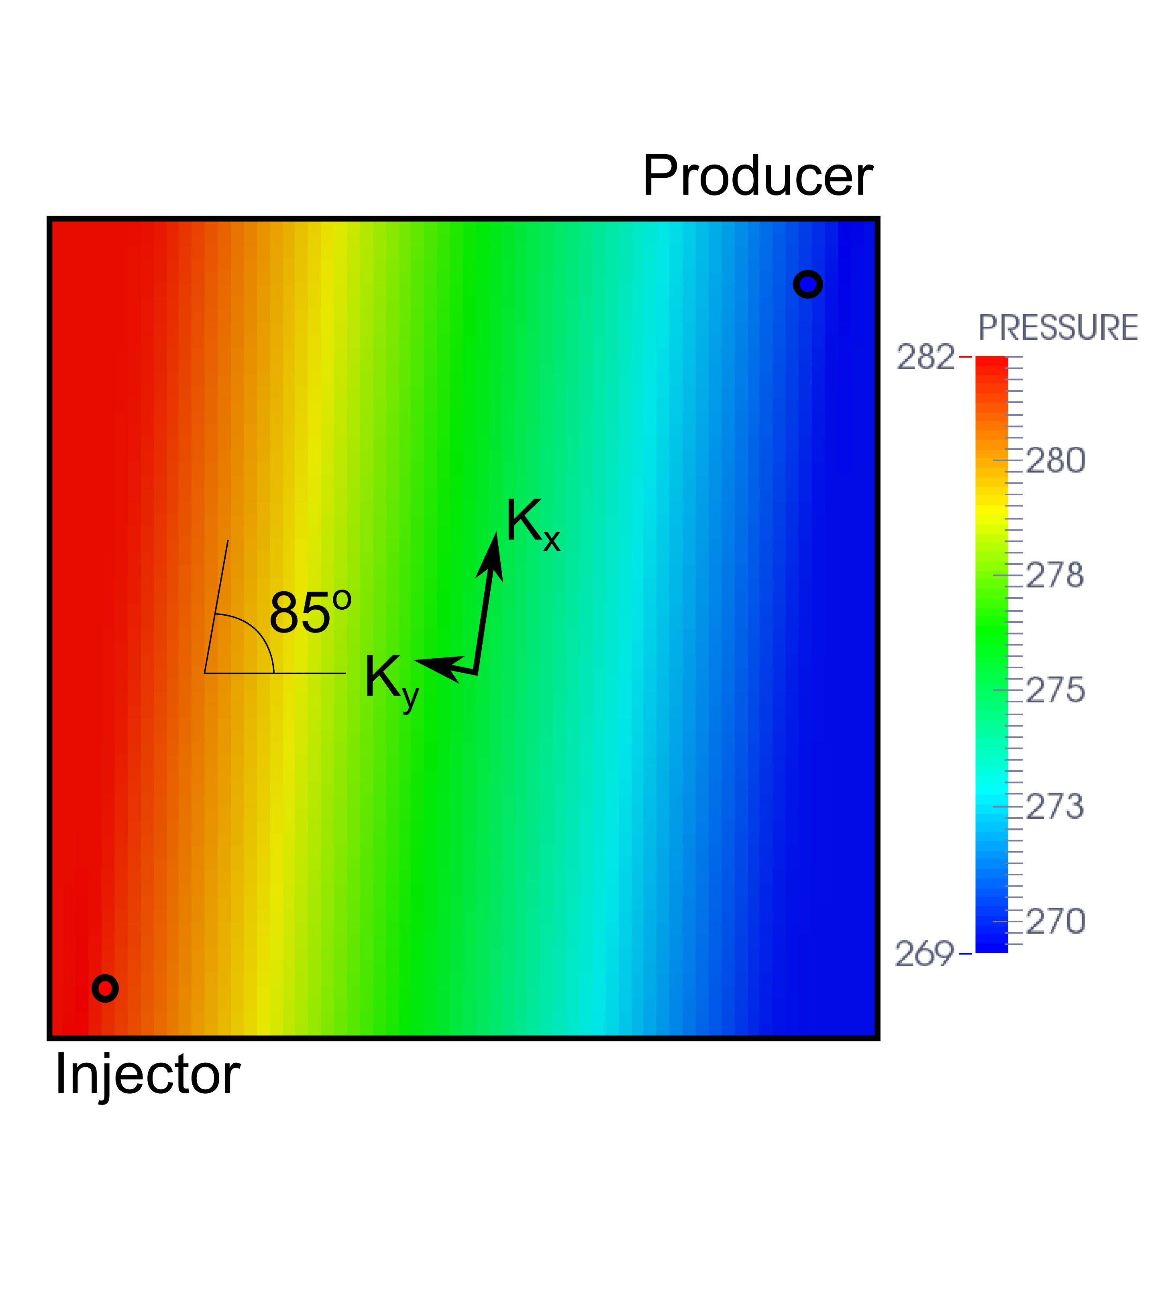
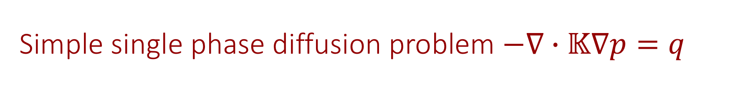
Simple single phase diffusion problem $−∇∙𝕂∇p=q$
TPFA, O(1)-error, incorrect
MPFA-O, O(h²)-error, accurate
Notes:
The Darcy law lays in the core of the typical reservoir simulator. To demonstrate the issues, we consider the darcy law with unit mobility that results in anisotropic diffusion problem. The problem considered is the problem with small permeability ratio and the tensor is slightly rotated, on the lower left corner there is an injection well on the upper right corner – a producer well. The grid is Cartesian, which is not K-orthogonal for this case. On the left we see the highly incorrect result with the two-point flux approximation method and on the right the accurate result with the second order accurate result obtained with MPFA-O method. The results is horrifying and while we may expect large inaccuracies from estimation of permeability, the numerics are supposed to be correct.

Slide 4
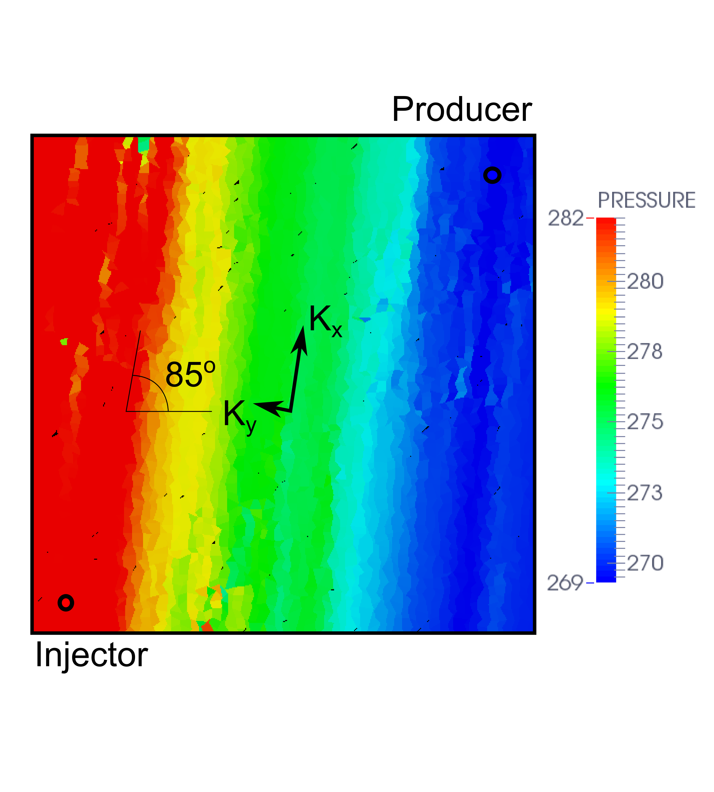
Simple single phase diffusion problem $−∇∙𝕂∇p=q$
Issues
MPFA-O
Issues
MPFA-O, Cartesian grid, accurate
MPFA-O, skewed Cartesian grid, unstable
Notes:
Although the MPFA-O scheme very well reproduces the solution on regular Cartesian grid, the result on randomly skewed grid is not as good and demonstrates unphysical violation of the discrete maximum principle. Such a behavior may have a huge negative effect on resulting rates of oil recovery. This fact welcomes a more robust alternative.

Slide 5
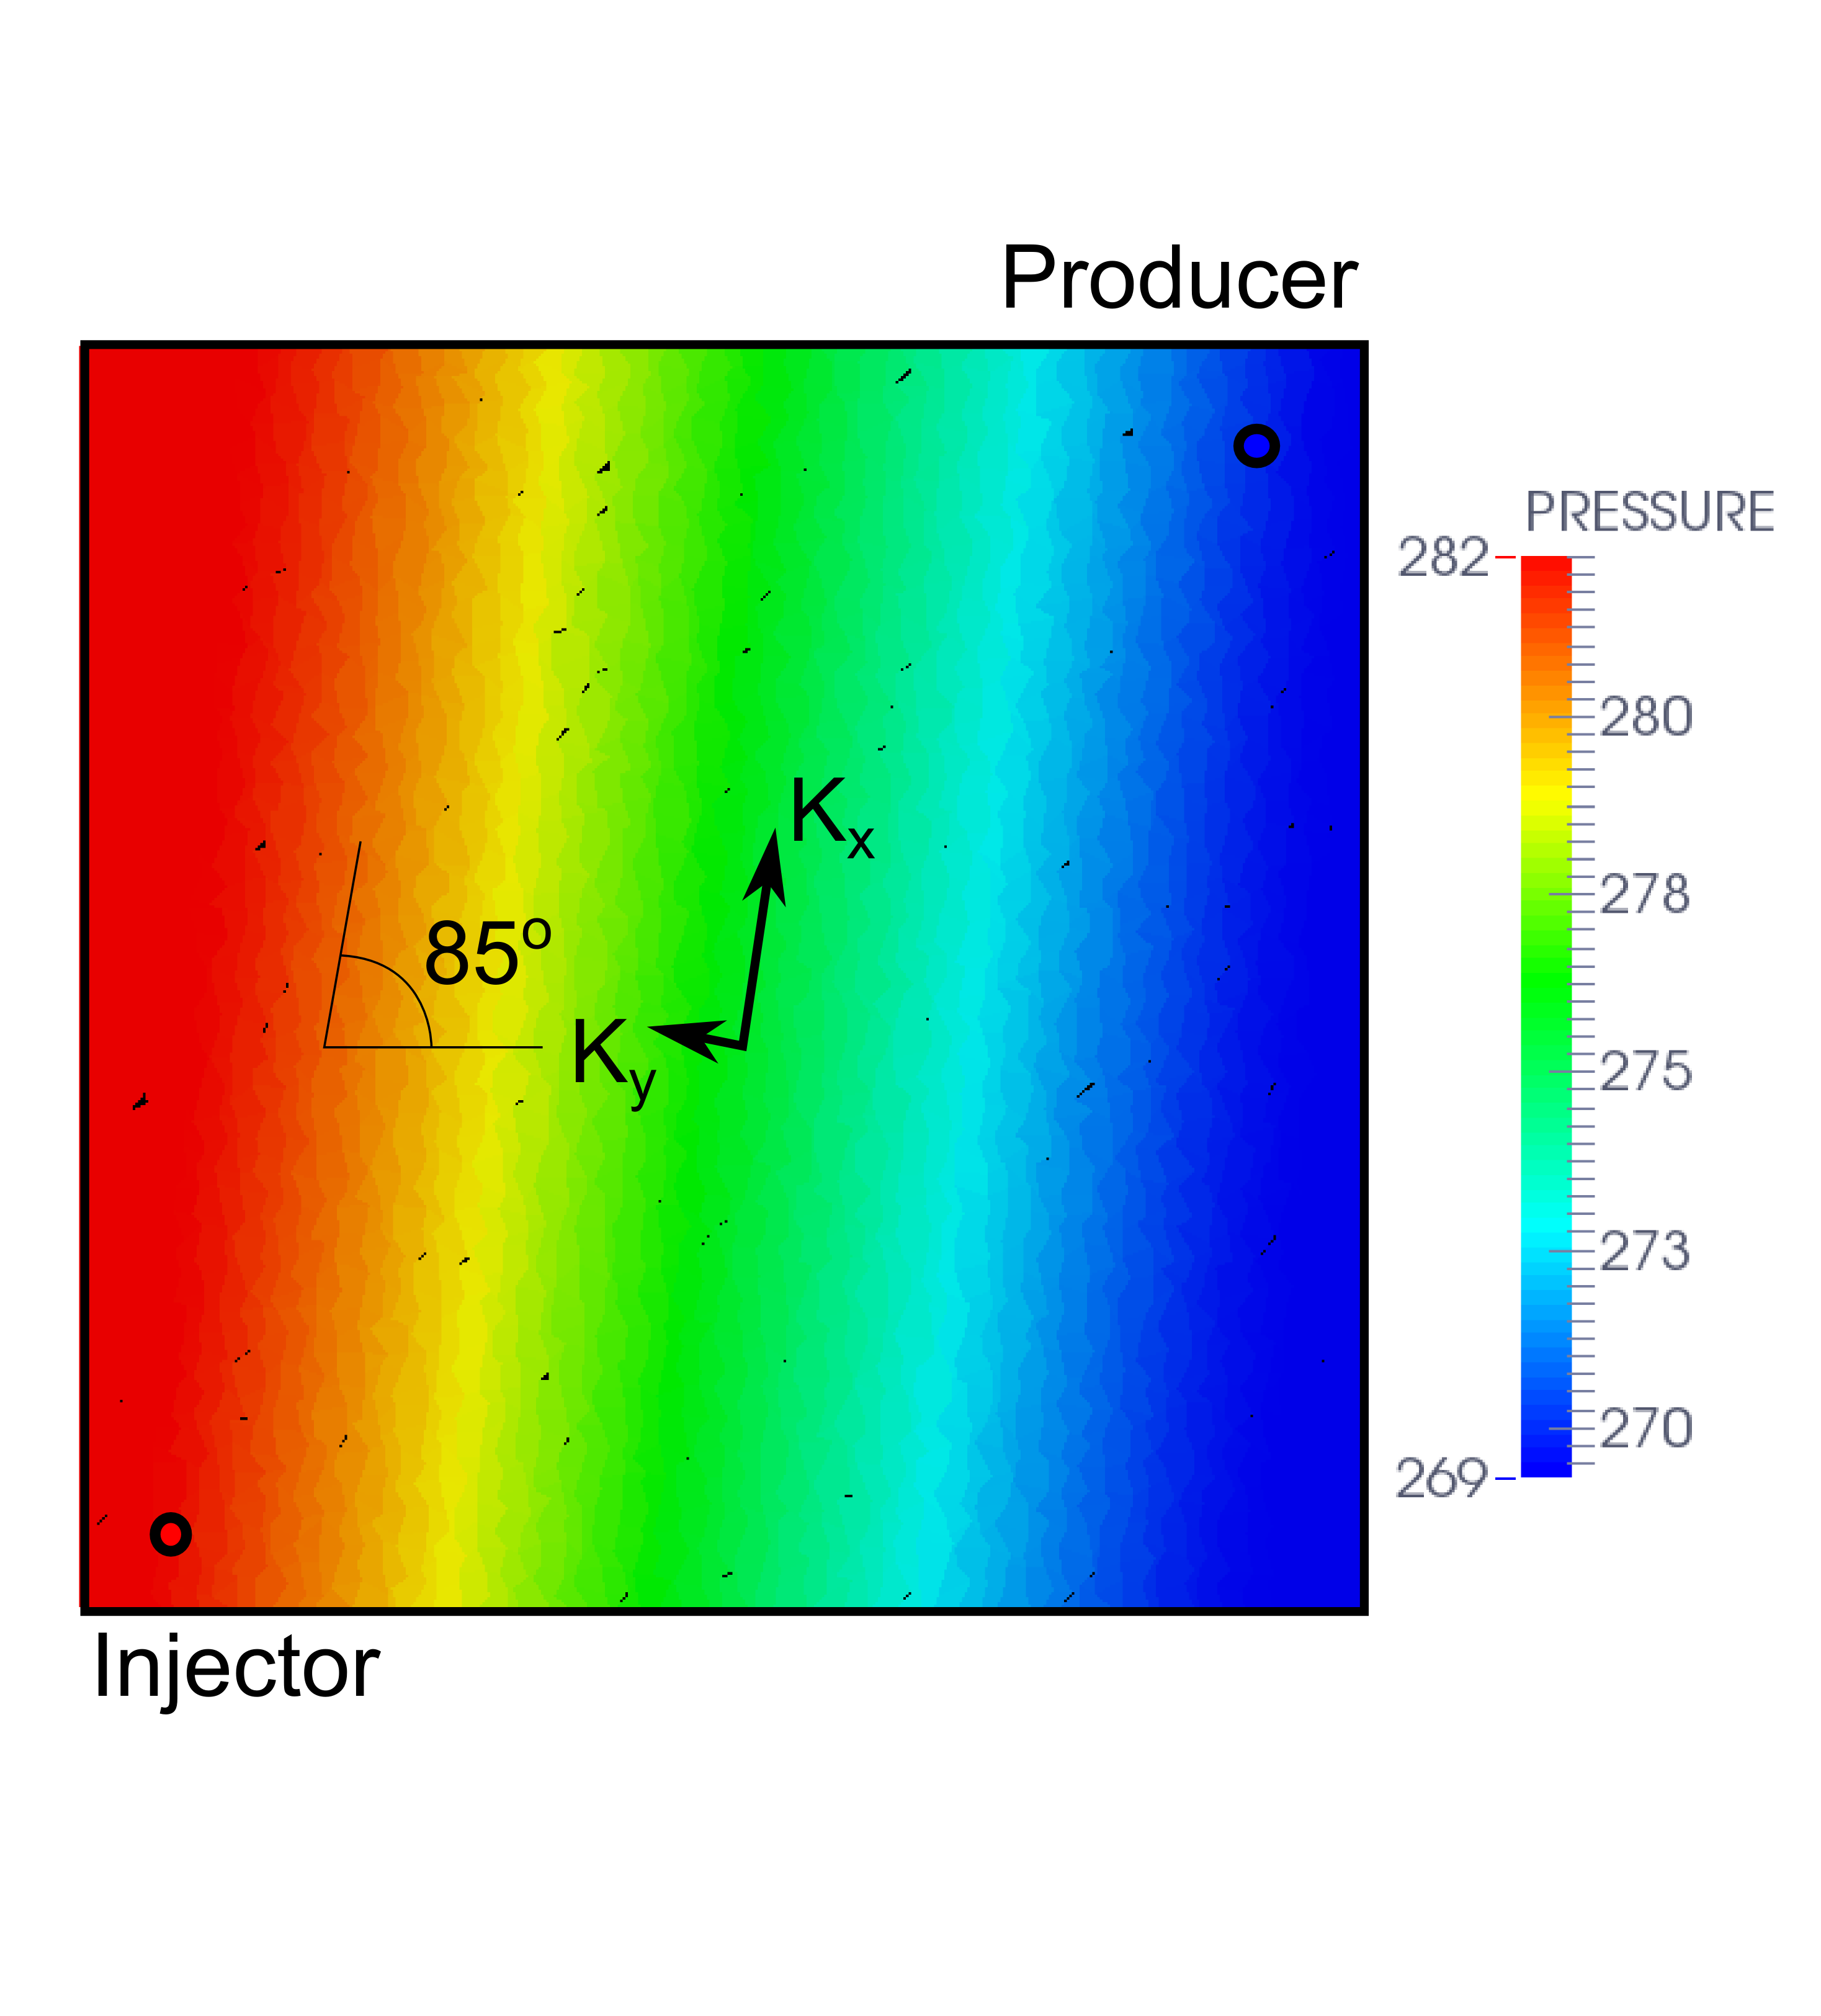
Simple single phase diffusion problem $−∇∙𝕂∇p=q$
MPFA-O, skewed Cartesian grid, unstable
Nonlinear scheme, skewed Cartesian grid, accurate
Notes:
Such an alternative is the nonlinear scheme. The accurate smooth result with nonlinear scheme is to the right, the previous unstable result with MPFA-O scheme is to the left. To achieve this we introduced dependence on the solution to the flux estimation and although the problem in question is linear the resulting approach is nonlinear. Why would we do this?

Slide 6
Transition to nonlinearity
No linear small stencil conservative scheme can be exact on linear solutions and respect the maximum principle.
[Kershaw 1981, Nordbotton 2005]
Notes:
Researchers noticed early that there is a problem with the combination of desired properties of the scheme. To achieve the discrete maximum principle, we have to either relax on small stencil (as far as I know this results in complete dependence, i.e. dense linear systems), conservativity which is highly undesirable, or accuracy, which is used with two-point flux approximation method.

Slide 7
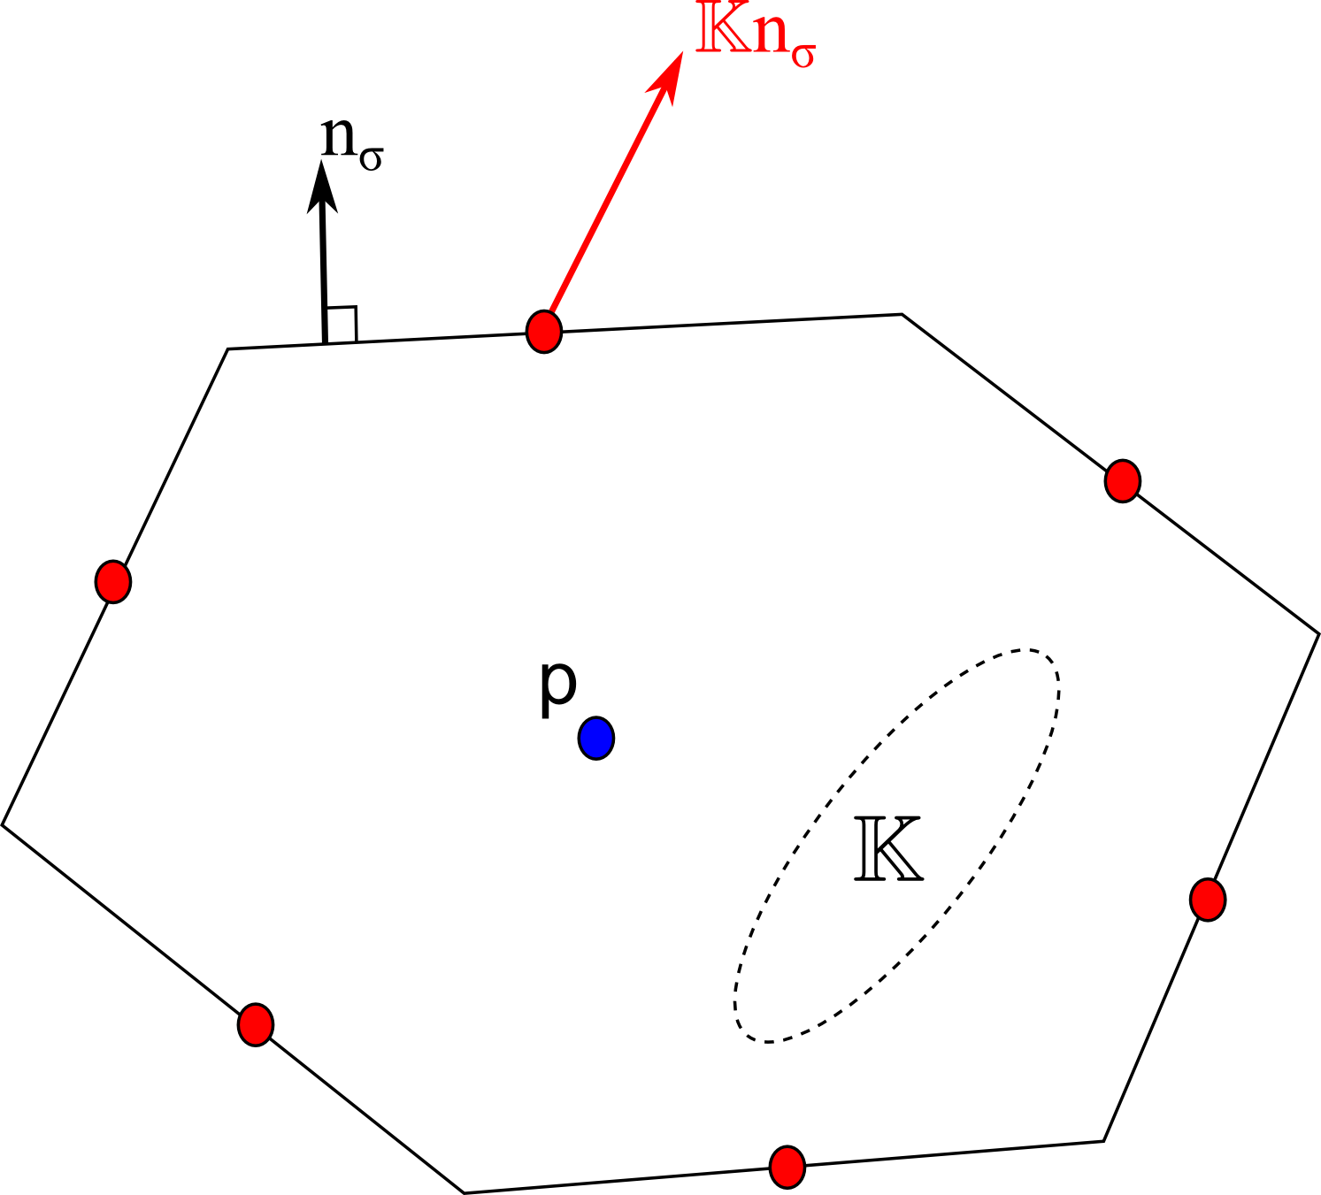
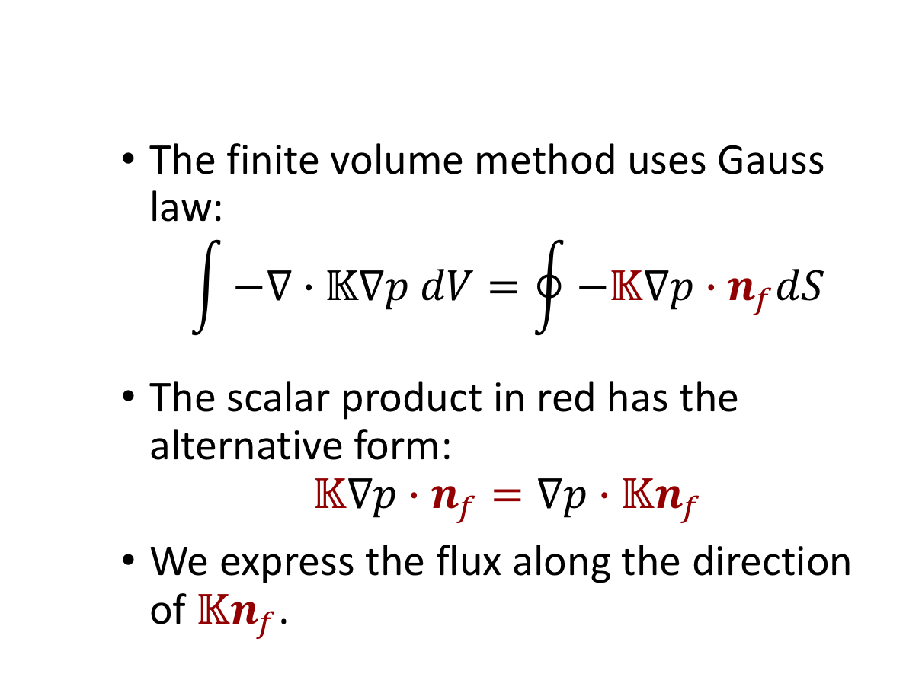
Diffusion Problem
The finite volume method uses Gauss law:
$$\int{−∇∙𝕂∇p dV=\oint{−𝕂∇p∙n_{f}dS}}$$
The scalar product in red has the alternative form:
$$𝕂∇p∙n_{f}=∇p∙𝕂n_{f}$$
We express the flux along the direction of $𝕂n_{f}$.
Notes:
Let us remind the construction of finite volume method in the case of anisotropic diffusion. (on picture) The pressure is considered to be defined at the centers of the cell, represented by blue dot and for finite volume method we have to determine the flux at the centers of the faces, represented by red dots. (first equation) The equation is considered in integral form and the intergral over volume of the cell is transformed into surface integral over faces of the cell. (second equation) The key ingredient in the method construction is the fact that in scalar product we can flip the tensor position from the gradient to the normal and after that manipulation in order to obtain the flux we have to determine the gradient of pressure along co-normal vector.

Slide 8
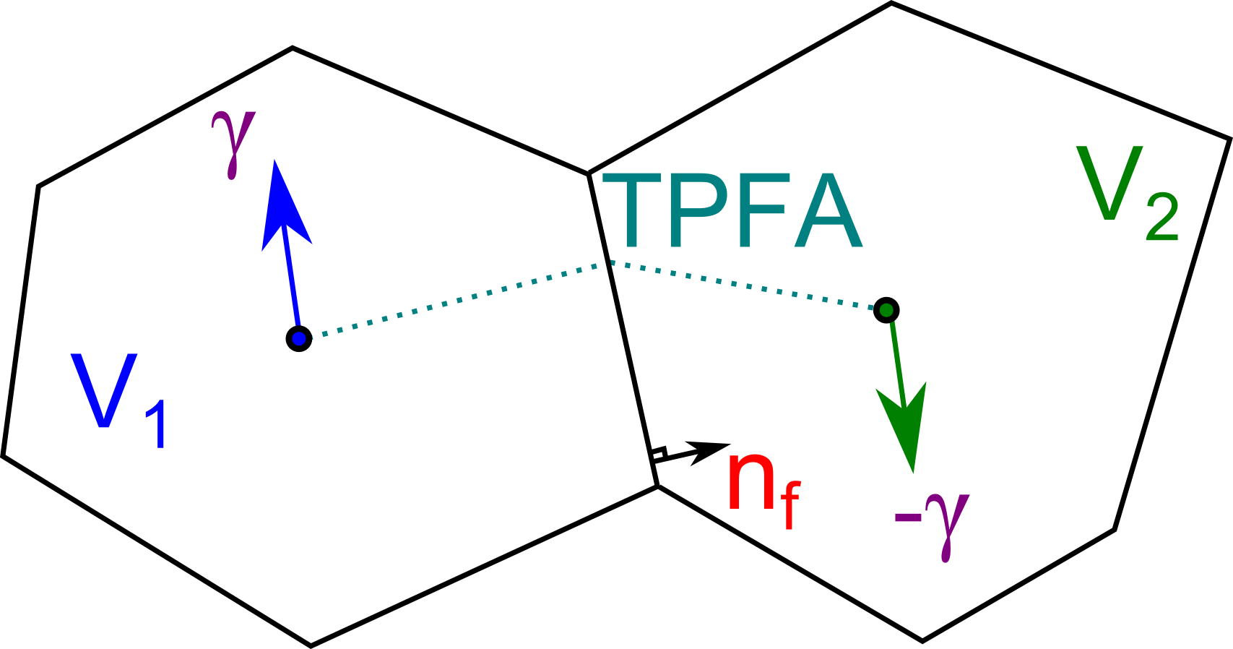
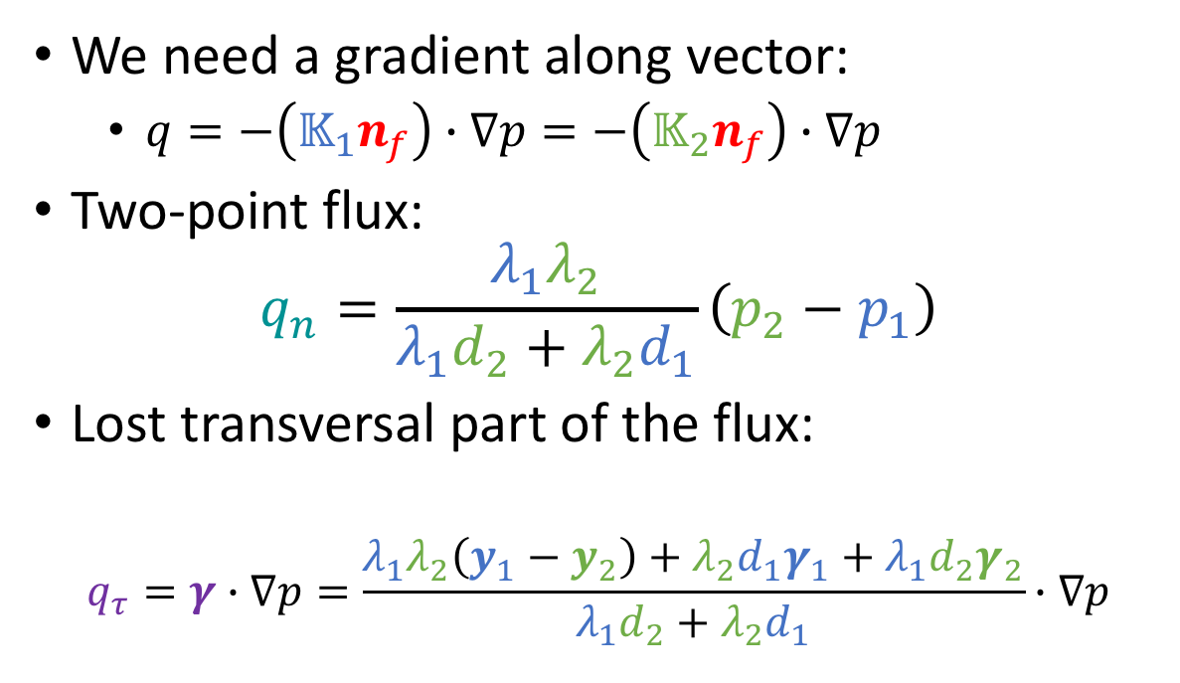
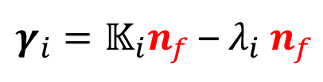
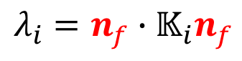
Diffusion Problem
We need a gradient along vector:
$q=−\left(𝕂_{1}n_{f}\right)∙∇p=−\left(𝕂_{2}n_{f}\right)∙∇p$
Two-point flux:
$$q_{n}=\frac{λ_{1}λ_{2}}{λ_{1}d_{2}+λ_{2}d_{1}}\left(p_{2}−p_{1}\right)$$
Lost transversal part of the flux:
$$q_{τ}=γ∙∇p=\frac{λ_{1}λ_{2}\left(y_{1}−y_{2}\right)+λ_{2}d_{1}γ_{1}+λ_{1}d_{2}γ_{2}}{λ_{1}d_{2}+λ_{2}d_{1}}∙∇p$$
$$λ_{i}=n_{f}∙𝕂_{i}n_{f}$$
$γ_{i}=𝕂_{i}n_{f}$ – $λ_{i} n_{f}$
Terekhov, Mallison, Tchelepi “Cell-Centered Nonlinear Finite-Volume Methods for the Heterogeneous Anisotropic Diffusion Problem”, JCP 2017
Notes:
In order to determine the flux over the interface in heterogeneous media we consider the continuity of the fluxes and the pressure; and decomposition of co-normals into orthogonal part (lambda) and transversal part (gamma). All the quantities are colored with blue and red for left and right cells, respectively. The continuity first yields us the two-point flux approximation method and second it results in vector gamma, common for both cells, that enters into scalar product of the missing transversal part in approximation of two-point flux approximation method. So the account of this part is important to recover the consistency of the two point flux approximation method, but it is hard to approximate it without violating stability. How do we achieve this?

Slide 9
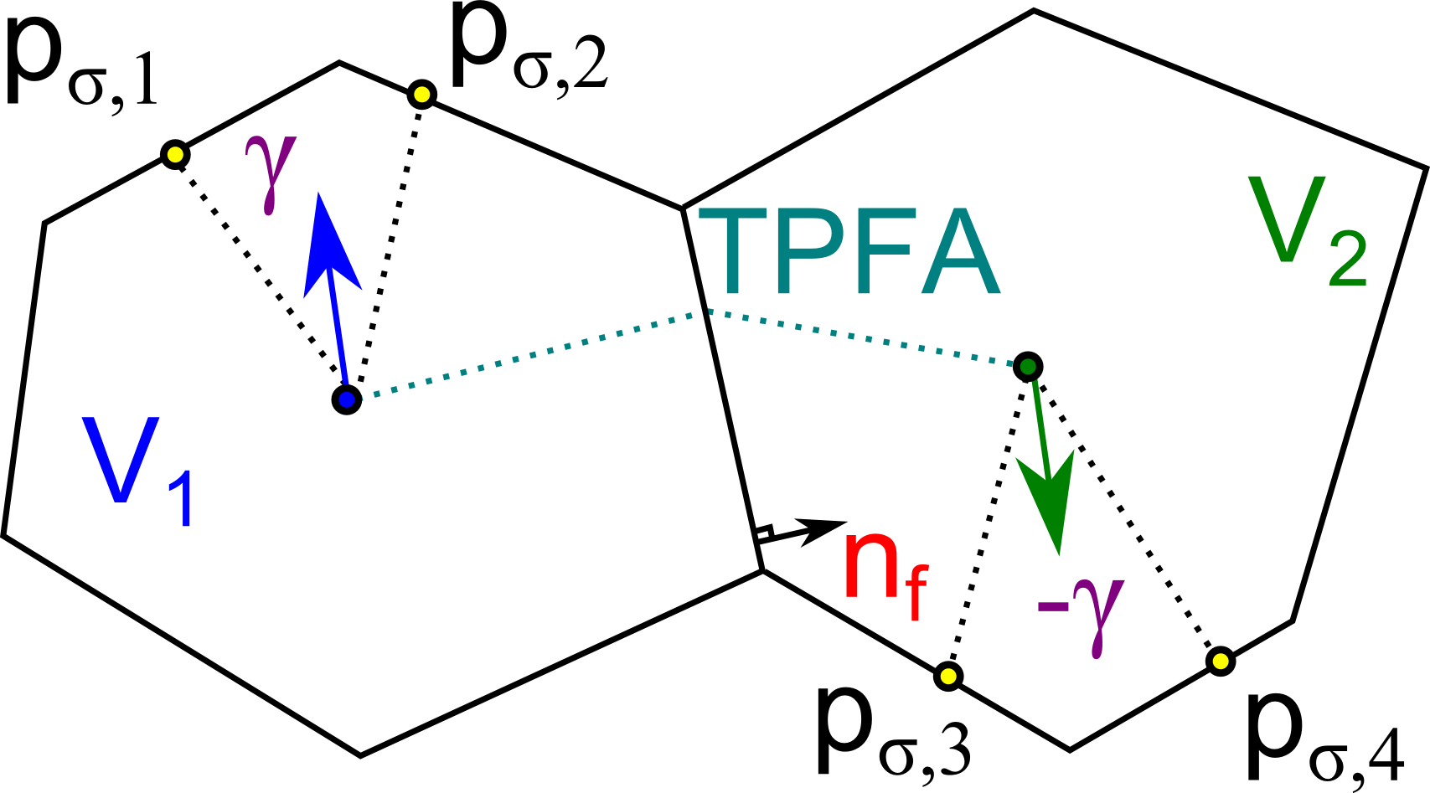
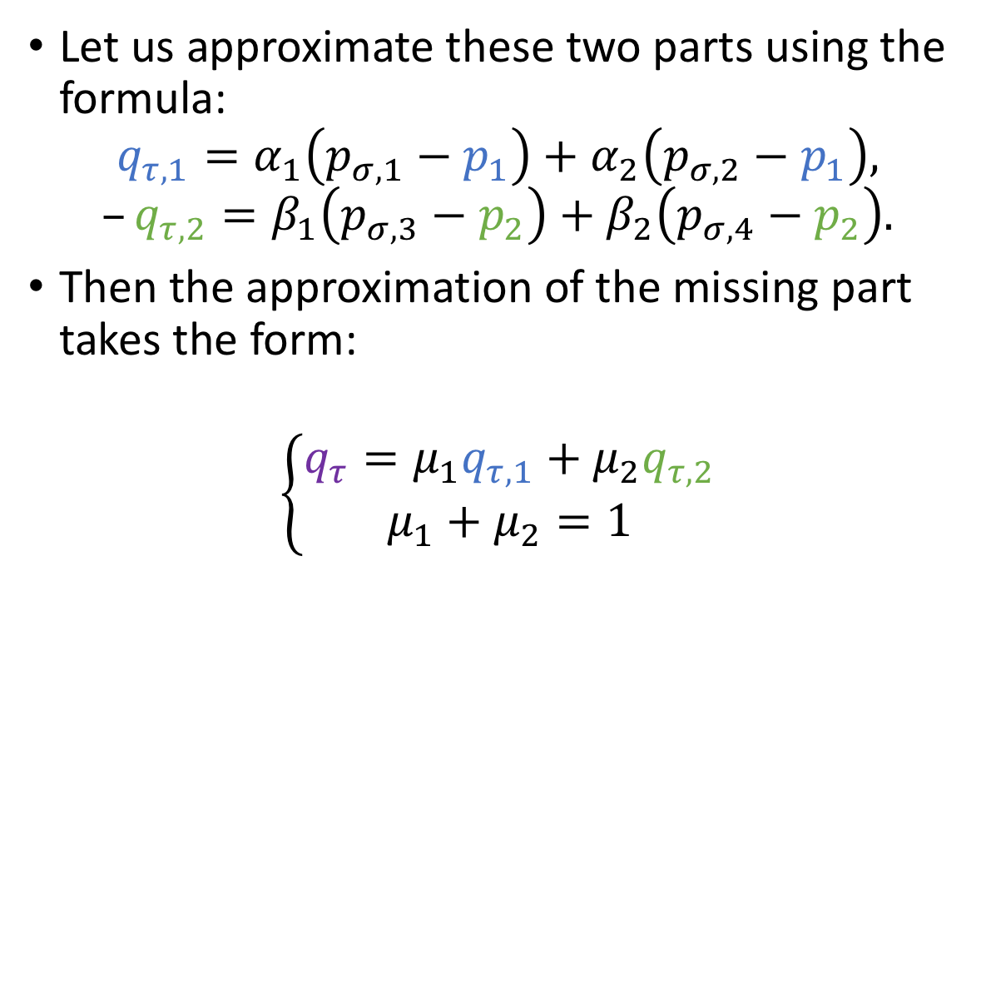
Diffusion Problem
Let us approximate these two parts using the formula:
$$q_{τ,1}=α_{1}\left(p_{σ,1}−p_{1}\right)+α_{2}\left(p_{σ,2}−p_{1}\right),$$
$$–q_{τ,2}=β_{1}\left(p_{σ,3}−p_{2}\right)+β_{2}\left(p_{σ,4}−p_{2}\right).$$
Then the approximation of the missing part takes the form:
$$\left\{\begin{matrix}q_{τ}=μ_{1}q_{τ,1}+μ_{2}q_{τ,2} \\ μ_{1}+μ_{2}=1\end{matrix}\right.$$
Notes:
Let us have some degrees of freedom or boundary conditions (pressures with sigma indices) that allow us to approximate the gradient of pressure along gamma vectors in each of the cells so that coefficients of alphas and betas is nonnegative. This results in two approximations of the flux in each of the cells. Then the final approximation for transversal part of the flux is given by convex combination of these two approximations. The key to stability of the method is the definition of mu.

Slide 10
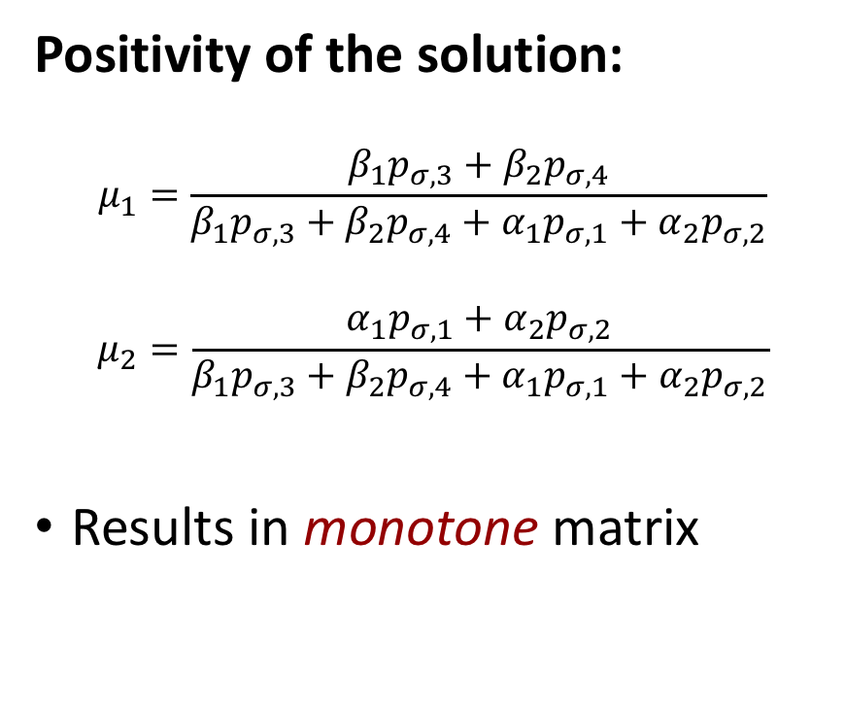
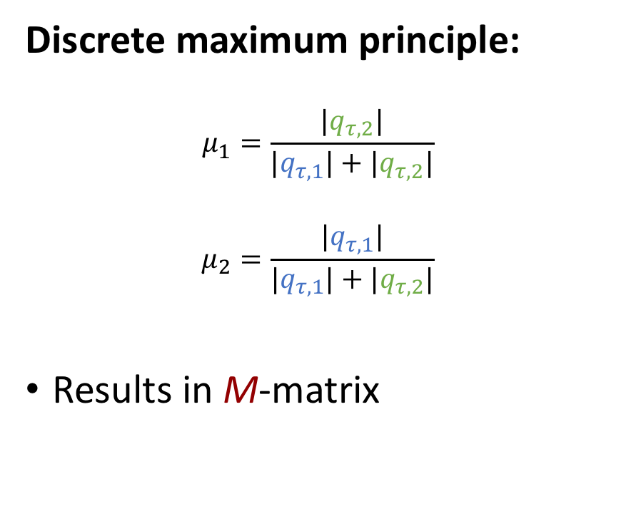
Nonlinear convex combination
Positivity of the solution:
$$μ_{1}=\frac{β_{1}p_{σ,3}+β_{2}p_{σ,4}}{{β_{1}p_{σ,3}+β}_{2}p_{σ,4}+α_{1}p_{σ,1}+α_{2}p_{σ,2}}$$
$$μ_{2}=\frac{α_{1}p_{σ,1}+α_{2}p_{σ,2}}{{β_{1}p_{σ,3}+β}_{2}p_{σ,4}+α_{1}p_{σ,1}+α_{2}p_{σ,2}}$$
Results in monotone matrix
Discrete maximum principle:
$$μ_{1}=\frac{|q_{τ,2}|}{|q_{τ,1}|+{|q}_{τ,2}|}$$
$$μ_{2}=\frac{|q_{τ,1}|}{|q_{τ,1}|+{|q}_{τ,2}|}$$
Results in M-matrix
Varga “Iterative Matrix Analysis”, 1962
Notes:
There are two possible choices of weights that result in desired properties for the scheme. From one side we can assemble nonlinear two-point scheme and obtain the positivity property since with Picard iterative method we obtain a monotone matrix that according to Varga (link in the bottom) is always positive. On the other side we can use van Albada limited averages to obtain a nonlinear multipoint scheme that produces an M-matrix and again according to Varga a highly desirable discrete maximum principle.

Slide 11
Overview
 | TPFA | MPFA | NTPFA | NMPFA
Approximation | NO! | YES | YES | YES
Robustness | YES | NO | YES | YES
Discrete Maximum Principle | YES | NO | NO | YES
Efficiency | YES | YES | YES | NO
MPFA
NTPFA
NMPFA
TPFA
?
All methods are available in AD-GPRS
Notes:
The TPFA scheme has a number of good properties, but the loss of approximation on non-K-orthogonal grids is very disturbing especially due to ubiquity of unstructured grids. It is impossible to construct K-orthogonal grids in any situation, which requires development of schemes working on general meshes. Although the discrete maximum principle is highly desirable, the derivative of the flux is not Lipschitz-continuous, the fact that deteriorates convergence rate of Newton method down to none. In previous works we demonstrated various techniques to improve on the problem, the usage of the good scheme is still a big compromise for efficiency. The search may happen in two directions – to construct Lipschitz-continuous flux (we did it and run into inflection point problems) and to consider nonlinear multigrid methods.

Slide 12
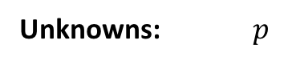
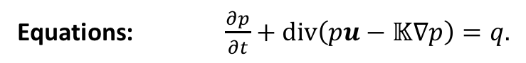
Advection problem
Unknowns: $p$
Equations: $\frac{∂p}{∂t}+div\left(pu−𝕂∇p\right)=q.$
Single point upstream method
Correction of single point upstream method
Notes:
Let us briefly consider an advection problem with the prescribed velocity u in porous heterogeneous media with tensor K. Let us take that the velocity vector points to the right, so that for the face between cells V1 and V2 the normal projection is positive. (picture to the left) A usual single point upstream method takes the blue pressure for pressure on interface which results in first order method. For the second order we have to shift the pressure onto interface. (picture to the right) We can achieve the second order of accuracy by considering corrections to single point upstream method. In the upstream cell the correction is denoted by the blue vector and in the downstream cell by the green vector. The coefficients are positive to the arrow of the vector and negative to the tail of the vector. The resulting flux is the single point upstream plus convex combination of corrections. The design of corrections is similar to co-normals in diffusion problem and yields an M-matrix if the velocity u is divergence-free. In the case of heterogeneous media the correction in downstream cell changes the direction according to interpolation method.

Slide 13
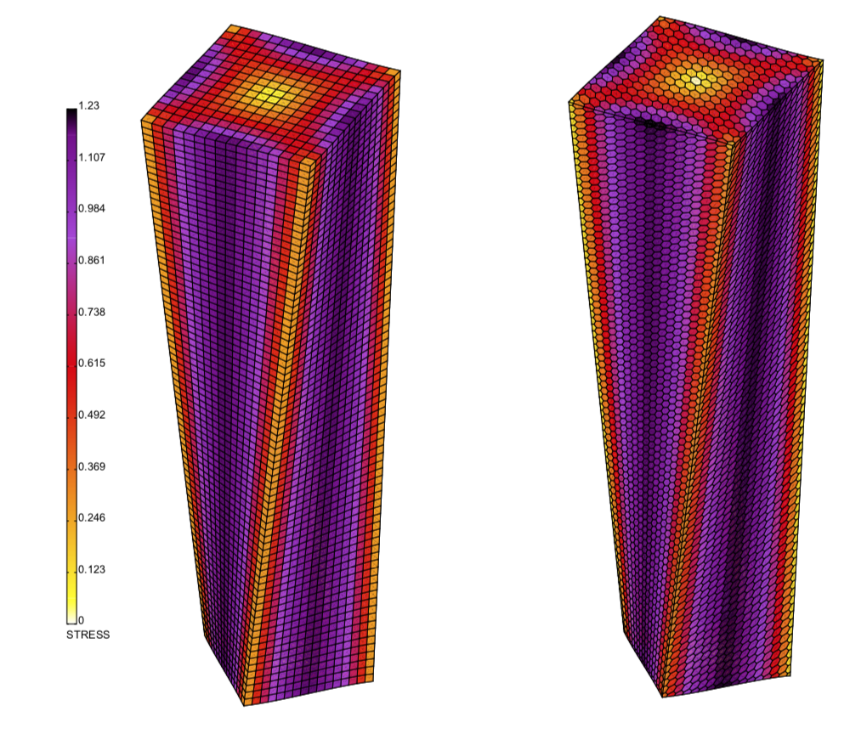
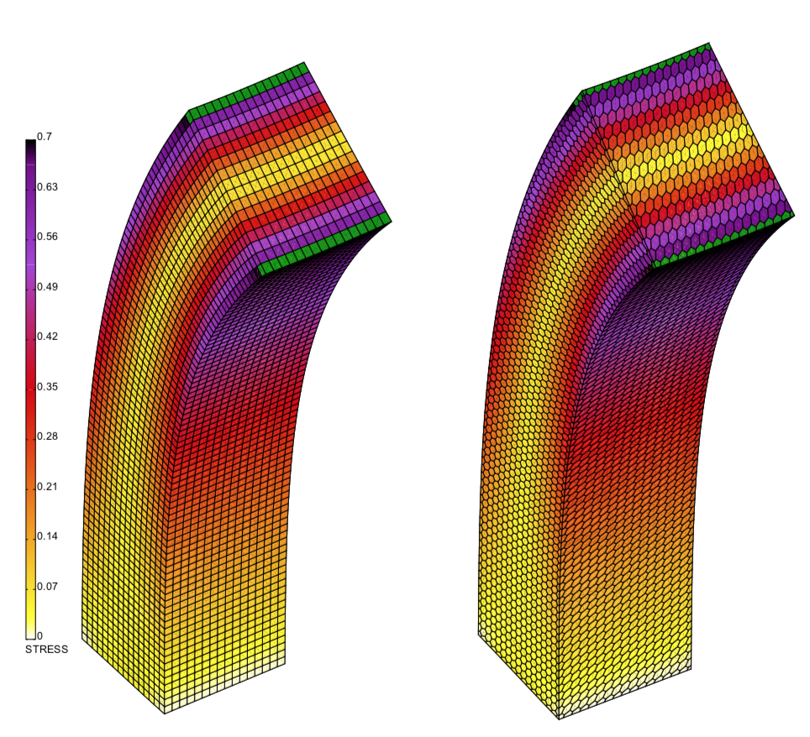
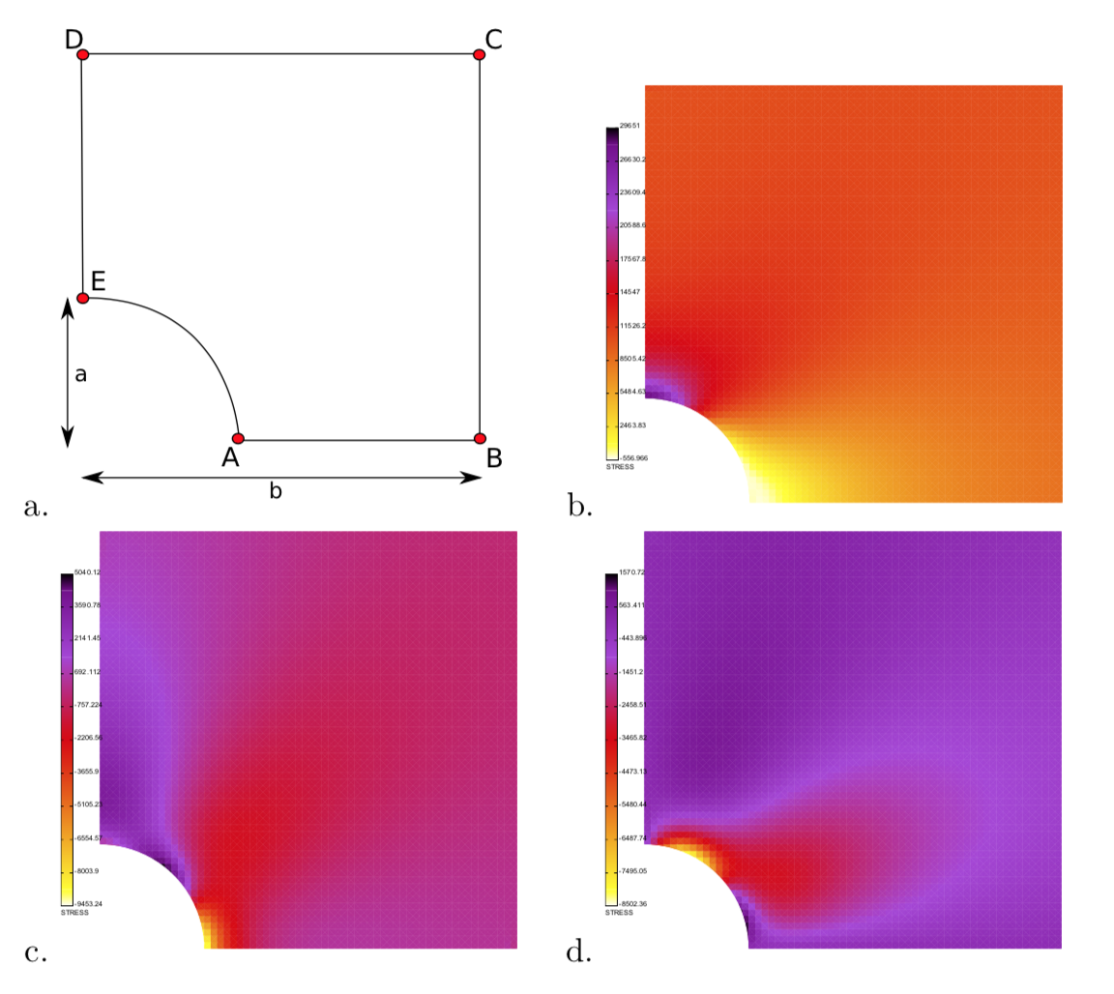
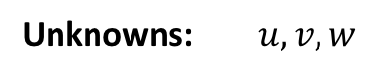
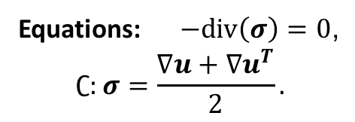
Linear Elasticity Problem
Unknowns: $u,v,w$
Equations: $−div\left(σ\right)=0$,
$$∁:σ=\frac{∇u+∇u^{T}}{2}.$$
Loading
Twist
Bend
Notes:
Let us further consider linear elasticity problem that may be characterized by heterogeneous anistropic elasticity 4-th order tensor C. The three pictures demonstrate the effects of loading of perforated strip, twisting and bending of the brick represented with cubic and dual grids. All three cases has respective analytical solutions and we propose the cell-centered finite volume method that demonstrates the second order accurate convergence in all three cases. In the following we describe the construction of such method.

Slide 14
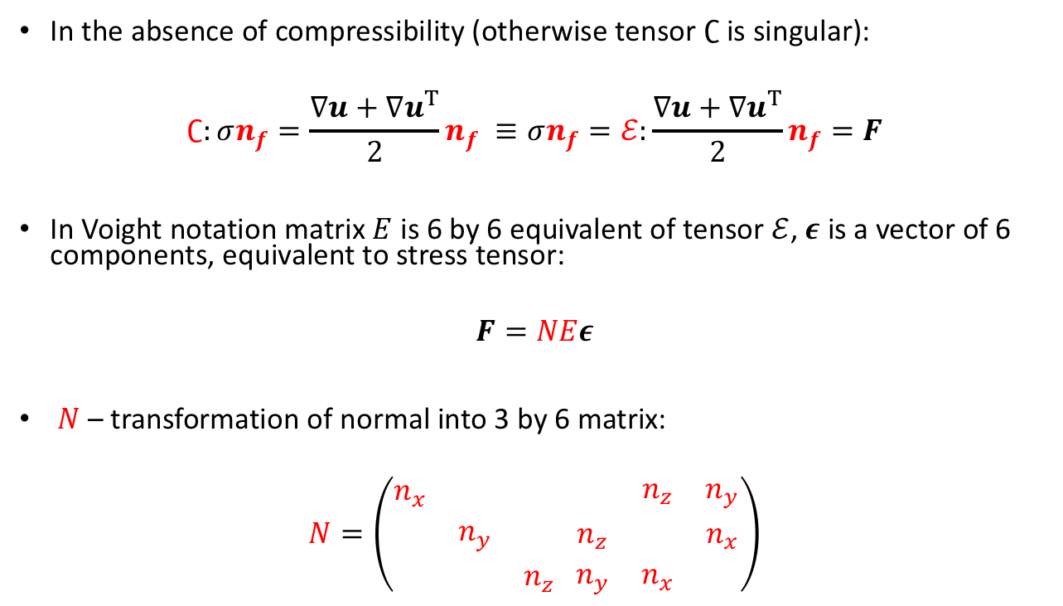
Linear Elasticity Problem
In the absence of compressibility (otherwise tensor $∁$ is singular):
$$∁:σn_{f}=\frac{∇u+{∇u}^{T}}{2}n_{f} ≡σn_{f}=ℰ:\frac{∇u+{∇u}^{T}}{2}n_{f}=F$$
In Voight notation matrix $E$ is 6 by 6 equivalent of tensor $ℰ$, $ε$ is a vector of 6 components, equivalent to stress tensor:
$$F=NEε$$
$N$ – transformation of normal into 3 by 6 matrix:
$$N=\left(\begin{matrix}n_{x} & & \\ & n_{y} & \\ & & n_{z}\end{matrix} \begin{matrix} & n_{z} & n_{y} \\ n_{z} & & n_{x} \\ n_{y} & n_{x} & \end{matrix}\right)$$
Notes:
Let us first note that at present we do not consider incompressible and rigid-tropic materials (in this case C is singular matrix and cannot be inverted, in case someone asks we can consider such materials by introducing structural pressure but this is another level of complexity). As in the case of the diffusion problem the main question for the finite volume method is how to define the flux on the interface (blue square) given that we have cell-centered displacements (red circle). (first equation) In order to obtain the flux expression we first invert the tensor. One may see that in case of linear elasticity equation it is not as easy to split the gradient of displacement and co-normal tensor, since we have a symmetric gradient and from the first sight it is unclear how do we put together the tensor with the normal as we did with anisotropic diffusion. (second equation) The next step is to transform the expression for the flux F to the Voight notation. and in Voight notation the matrix N, corresponding to normal and symmetric matrix E, corresponding to tensor indeed appear together. The epsilon vector is the vector corresponding to strain tensor in Voight notation. (third equation) The N matrix has this form, the expression is not something that is easy to find in a book on mechanics.

Slide 15
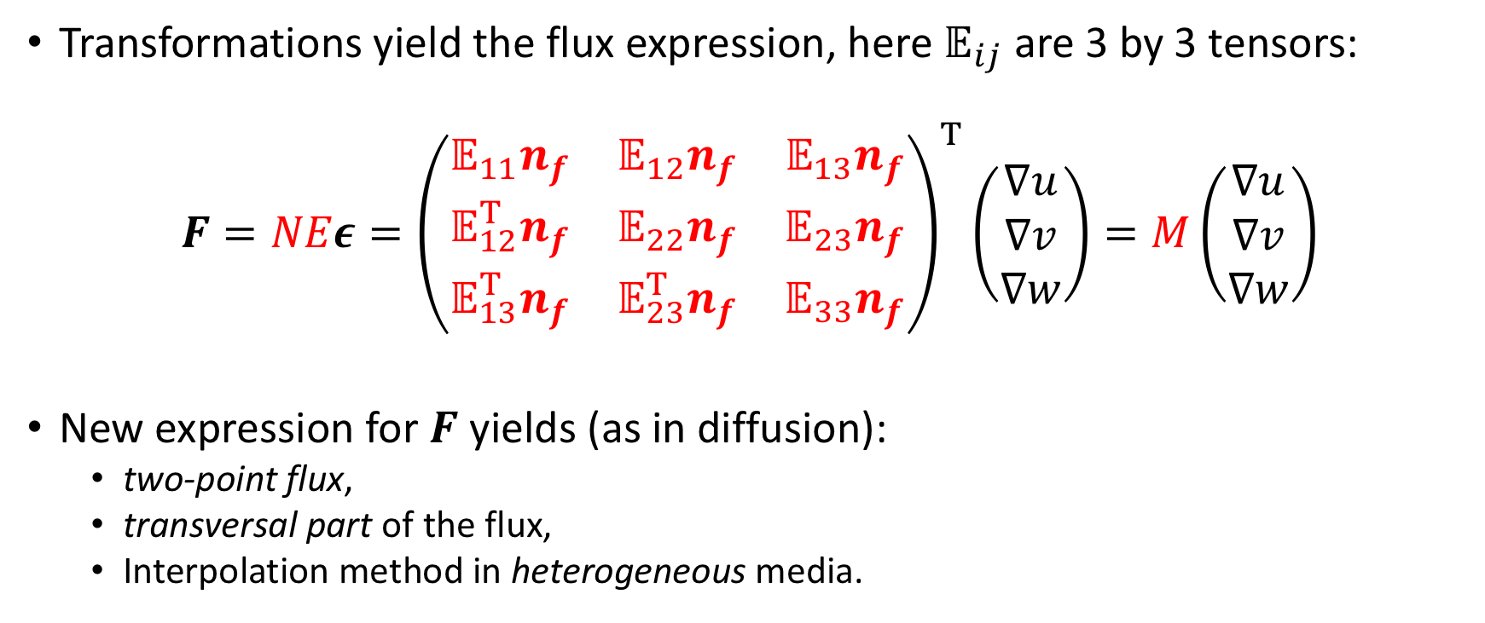
Linear Elasticity Problem
Transformations yield the flux expression, here $𝔼_{ij}$ are 3 by 3 tensors:
$$F=NEε={\left(\begin{matrix}𝔼_{11}n_{f} & 𝔼_{12}n_{f} & 𝔼_{13}n_{f} \\ 𝔼_{12}^{T}n_{f} & 𝔼_{22}n_{f} & 𝔼_{23}n_{f} \\ 𝔼_{13}^{T}n_{f} & 𝔼_{23}^{T}n_{f} & 𝔼_{33}n_{f}\end{matrix}\right)}^{T}\left(\begin{matrix}∇u \\ ∇v \\ ∇w\end{matrix}\right)=M\left(\begin{matrix}∇u \\ ∇v \\ ∇w\end{matrix}\right)$$
New expression for $F$ yields (as in diffusion):
two-point flux,
transversal part of the flux,
Interpolation method in heterogeneous media.
Notes:
Analysis of expression provided by the Voight notation allows us to obtain 9 co-normal vectors, similar to those that we have seen in diffusion. Let us call the 3 by 9 M matrix here as the co-normal tensor. In the following we will introduce the two-point flux expression, the transversal correction to the flux. The form also allows one to introduce MPFA-O scheme for elasticity without utilizing weak symmetry as Jan Martin Nordbotten did.

Slide 16
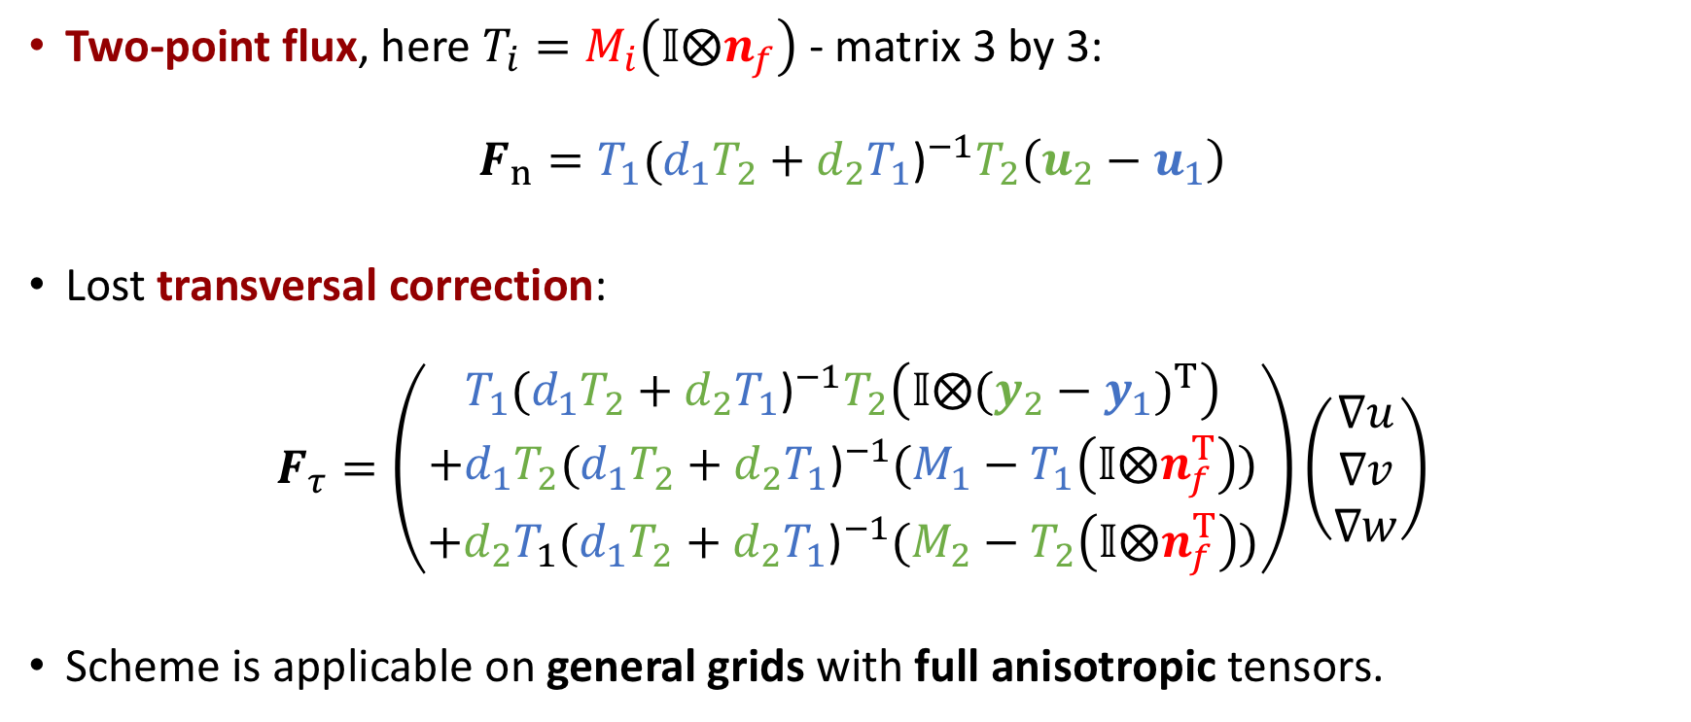
Linear Elasticity Problem
Two-point flux, here $T_{i}=M_{i}\left(𝕀⨂n_{f}\right)$ - matrix 3 by 3:
$$F_{n}=T_{1}{(d_{1}T_{2}+d_{2}T_{1}\text{)}}^{−1}T_{2}\left(u_{2}−u_{1}\right)$$
Lost transversal correction:
$$F_{τ}=\left(\begin{aligned}T_{1}{(d_{1}T_{2}+d_{2}T_{1}\text{)}}^{−1}T_{2}\left(𝕀⨂{(y_{2}−y_{1})}^{T}\right) \\ +d_{1}T_{2}{(d_{1}T_{2}+d_{2}T_{1}\text{)}}^{−1}(M_{1}−T_{1}\left(𝕀⨂n_{f}^{T}\right)) \\ +{d_{2}T}_{1}{(d_{1}T_{2}+d_{2}T_{1}\text{)}}^{−1}(M_{2}−T_{2}\left(𝕀⨂n_{f}^{T}\right))\end{aligned}\right)\left(\begin{matrix}∇u \\ ∇v \\ ∇w\end{matrix}\right)$$
Scheme is applicable on general grids with full anisotropic tensors.
Tensorial harmonic average
Terekhov, Tchelepi “Cell-centered finite volume method for heterogeneous full-tensor anisotropic linear elasticity”, in preparation
Notes:
Following the design pattern of the anisotropic diffusion scheme we can derive the two point flux approximation scheme for elasticity problem (first equation) and the missing transversal part of the flux (second equation). Note that here T is the projection of tensorial co-normal onto normal which corresponds to lambda in the case of anisotropic diffusion equation and as we’ve got the harmonic average for lambda’s in the same fashion we get tensorial harmonic averaging for T’s. We haven’t yet tried to create a nonlinear scheme because it is not yet completely clear what property do we want to satisfy by nonlinear method. But the results that would follow suggest certain path.

Slide 17
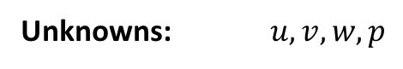
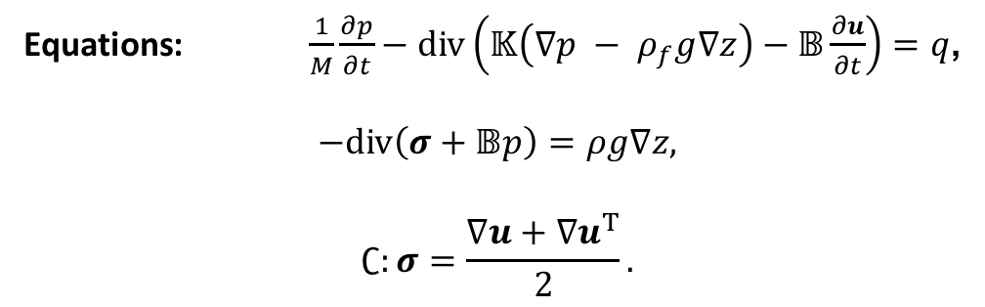
Poromechanics
Unknowns: $u,v,w,p$
Equations: $\frac{1}{M}\frac{∂p}{∂t}−div\left(𝕂\left(∇p − ρ_{f}g∇z\right)−𝔹\frac{∂u}{∂t}\right)=q$,
$$−div\left(σ+𝔹p\right)=ρg∇z,$$
$$∁:σ=\frac{∇u+{∇u}^{T}}{2}.$$
We followed the same design as for diffusion and elasticity but run into a complication
Notes:
For poromechanics we considered the Biot equations that couple the Darcy law with linear elasticity via Biot term. We followed a similar design pattern to obtain the flux expression but run into a complication. The complication arises from the fact that we’ve got a saddle point system.

Slide 18
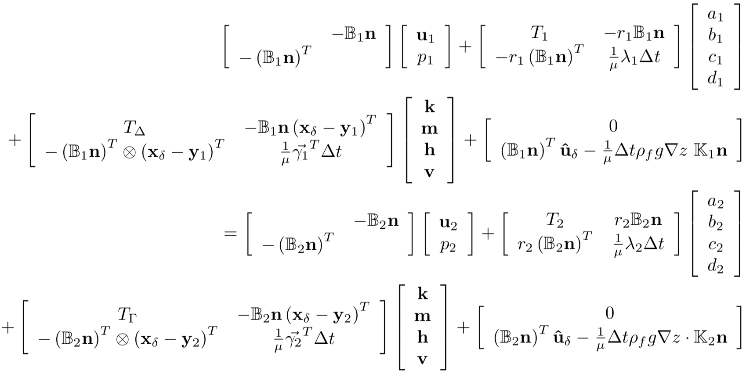
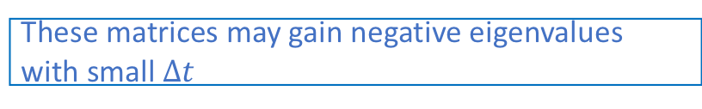
Poromechanics
These matrices may gain negative eigenvalues with small $∆t$
Expression for flux equality:
These matrices contain one negative and one positive eigenvalue
Terekhov, Castelleto, Tchelepi “A finite volume method for heterogeneous anisotropic geomechanics”, in preparation
Notes:
The presented formula is the intermediate step in the derivation of the scheme. Here we have split the gradients of u,v,w,p into normal part (a,b,c,d) and transversal part (k,m,h,v). The multiplying matrices here have negative eigenvalues that enter the final formulas. These negative eigenvalues act as a negative transmissibility. As the negative transmissibility ruin the solution in scalar case, it has the same consequences in vectorial case. Since the reason behind this behavior is the saddle-point nature of the system, introduced by Biot coupling term, let us consider a simpler problem of incompressible fluid flow.

Slide 19
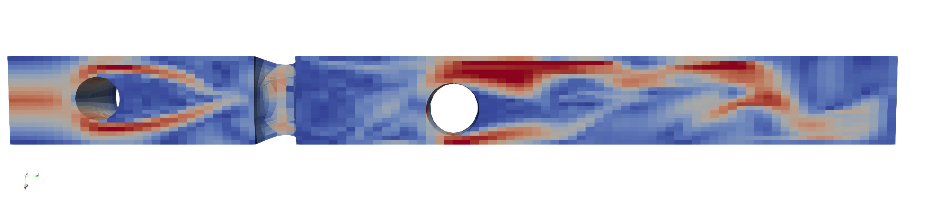
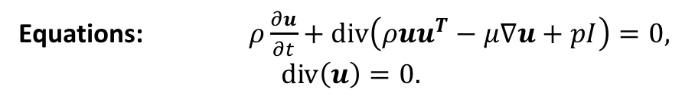
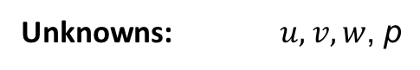
Incompressible Navier-Stokes
Unknowns: $u,v,w\text{,} \text{p}$
Equations: $ρ\frac{∂u}{∂t}+div\left(ρuu^{T}−μ∇u+pI\right)=0,$
$$div\left(u\right)=0.$$
Flow in the channel with cylindrical obstacles
Notes:
The problem was considered by coincidence due to necessity to model blood flow with a clot. The incompressible Navier-Stokes equations represent the classic saddle-point system. One of the usual ways is to consider staggered method – the pressure is located at cell centers and the normal projection of the velocity is stored on faces. The approach usually do not allow to conserve the momentum and becomes very complex on unstructured grids (see works by Blair Perot). Here we consider a collocated method, that means the velocity vector and pressure are both located at cell centers. A direct approximation with this arrangement of unknowns usually lead to checkerboard pattern in pressure, the solution is unphysical.

Slide 20
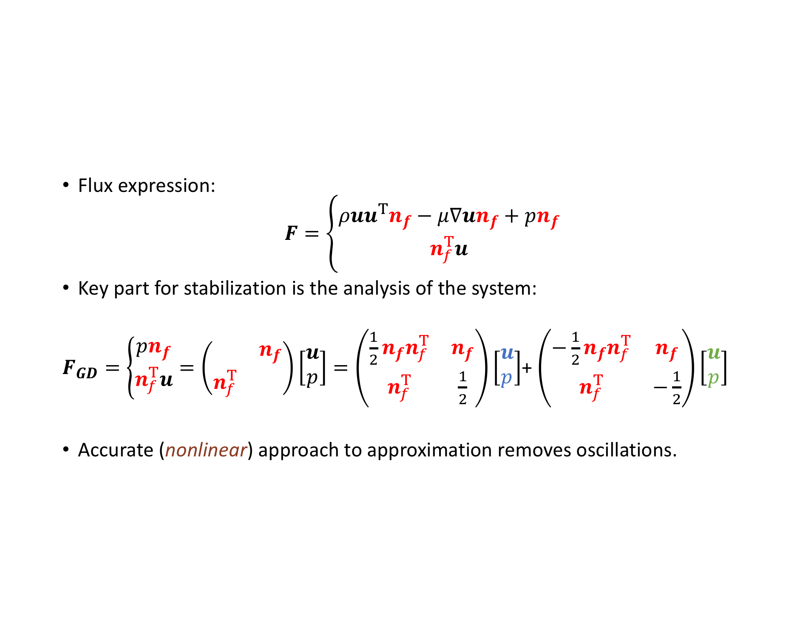
Incompressible Navier-Stokes
Flux expression:
$$F=\left\{\begin{aligned}ρuu^{T}n_{f}−μ∇un_{f}+pn_{f} \\ n_{f}^{T}u\end{aligned}\right.$$
Key part for stabilization is the analysis of the system:
$F_{GD}=\left\{\begin{aligned}pn_{f} \\ n_{f}^{T}u\end{aligned}\right.=\left(\begin{matrix} & n_{f} \\ n_{f}^{T} & \end{matrix}\right)\left[\begin{matrix}u \\ p\end{matrix}\right]=\left(\begin{matrix}\frac{1}{2}n_{f}n_{f}^{T} & n_{f} \\ n_{f}^{T} & \frac{1}{2}\end{matrix}\right)\left[\begin{matrix}u \\ p\end{matrix}\right]$+ $\left(\begin{matrix}−\frac{1}{2}n_{f}n_{f}^{T} & n_{f} \\ n_{f}^{T} & −\frac{1}{2}\end{matrix}\right)\left[\begin{matrix}u \\ p\end{matrix}\right]$
Accurate (nonlinear) approach to approximation removes oscillations.
Positive and negative
eigenvalues
Positive eigenvalue
Negative eigenvalue
Terekhov, Vassilevski “LBB-stable collocated finite-volume method for incompressible Navier-Stokes equations”, In preparation
Notes:
Let us consider the definition of the flux. Let us extract the part of the gradient of pressure and the divergence of velocity. As we have noticed previously in poromechanics problem, this part of the flux has a matrix multiplier with exactly one negative eigenvalue and one positive eigenvalue. With eigen-decomposition we can split this matrix into two matrices with positive eigenvalue and negative eigenvalue. An accurate approximation (recall the advection problem) of the velocity and pressure leads to a block-structured matrix with positive-definite block on the diagonal and negative-definite blocks off-diagonal. From the numerous tests we see that the physical solution is recovered with the new approach. Although there is no such theory for matrices of this structure in the literature, as there is in Varga’s book for M-matrices, this block-M-matrix structure is something that we should look for when constructing nonlinear methods for elasticity and poromechanics.

Slide 21
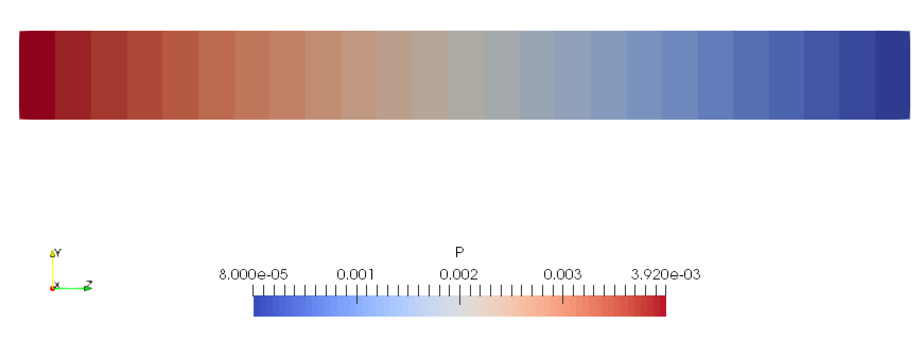
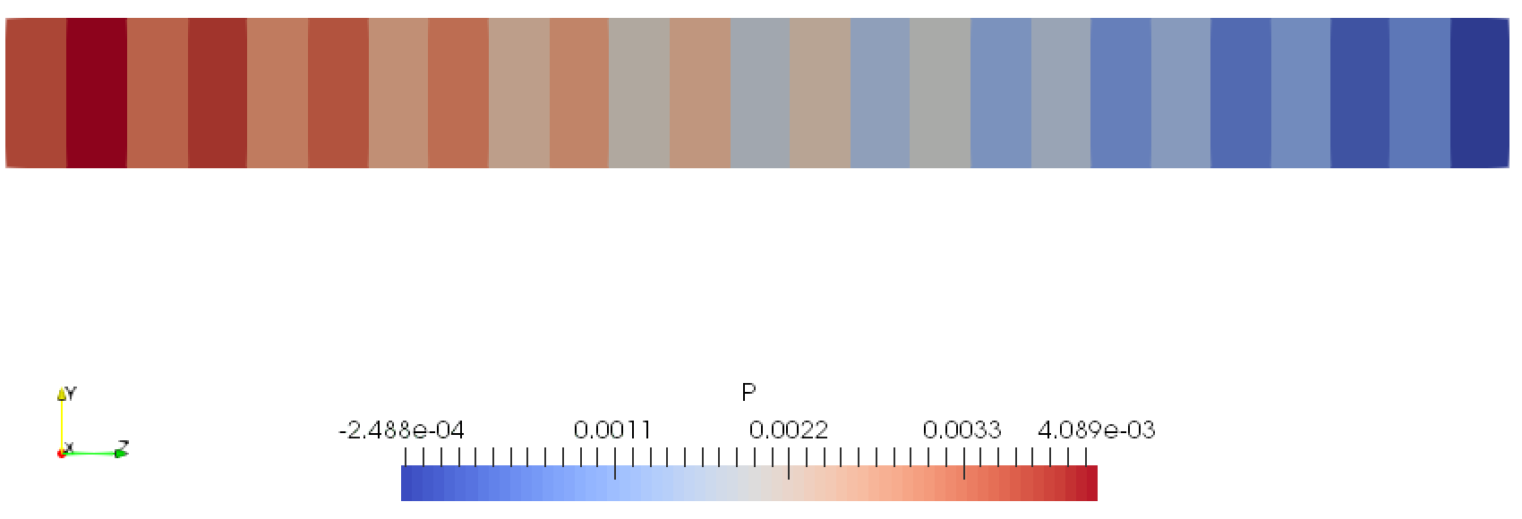
Incompressible Navier-Stokes
Poiseuille flow:
Demonstrates second-order convergence on Ethier-Steinman problem, error norms are comparable to projection scheme on staggered grid (MAC-scheme).
Positive-definite div-grad
Direct approximation of div-grad
Notes:
Let us demonstrate the recovery of the physical pressure with a simple problem of Poiseuille flow in a pipe. As we can see to the right the unphysical checkerboard pattern in the flow direction is present with naïve approximation method. The picture to the left demonstrates that the pressure is smooth with the new method. On analytical problems the method demonstrates the second order of accuracy.

Slide 22
Future steps
Apply the idea to poromechanics problem in heterogeneous media.
Formulate a general finite-volume approach for flux calculation (there are promising results with nonlinear hyperbolic problems).
Notes:
The presented idea could be readily extended to the poromechanics problem. The challenge with the poromechanics is the heterogeneity of the media which greatly complicates the derivation. It was much easier to consider navier-stokes equations since we can readily use adjacent degrees of freedom to recover the gradients. Even more challenging task is to provide the strategy to the approximation of the flux that lead to block-M-matrix structure. There are some results with nonlinear hyperbolic problems that indicate that we may have to solve an eigenvalue optimization problem in order to find the correct approximation of the flux.

Slide 23

Thank you for Attention!
Bradley malLison
Nicola castelletto
Notes:
I would like to thank Brad for fruitful discussions on diffusion problem and introduction to advection problem in porous media, the consideration of advection problem was an essential part to the solution of present problem; Nicola for introduction to poromechanics problem; Yuri for suggestion to consider blood clotting problem that posed many significant problems, one of which required consideration of fully implicit method for incompressible navier-stokes problem.

